Slide 1
Superscalar processors
Review

Slide 2
Dependence graph
Nodes: instructions
Edges: ordered relations among the instructions
Any ordering-based transformation that does not change the dependencies of the program will be guarantied not to change the result of the program.
Example
S1: Load R1, A / R1 ← Memory (A) /
S2: Add R2, R1 / R2 ← R2+R1 /
S1
S2

Slide 3
Data dependency
Flow dependence: Statement 2 uses a variable computed by Statement 1. Statement 1 must store/send the variable before Statement 2 fetches.
S1 → S2
Output dependence : Statement 1 and Statement 2 both compute the same variable and Statement 2's value must be stored/sent after Statement 1's.
S1 S2
Antidependence: Statement 1 reads from a location into which the second statement stores. S1 S2
Example
S1: Load R1, A / R1 ← Memory (A) /
S2: Add R2, R1 / R2 ← R2+R1 /
S3: Move R1, R3 / R1 ← R3 /
S4: Store B, R1 / Memory (B) ← R3 /
S1
S2
S4
S3

Slide 4
EXAMPLE
How long would the following sequence of instructions take to execute on an superscalar processor with two execution units, each of which can execute any instruction? Load operations have a latency of two cycles, and all other operations have a latency of one cycle. Assume that the pipeline depth is 5 stages.
LD r1, (r2)
ADD r3, r1, r4
SUB r5, r6, r7
MUL r8, r9, r10

Slide 5
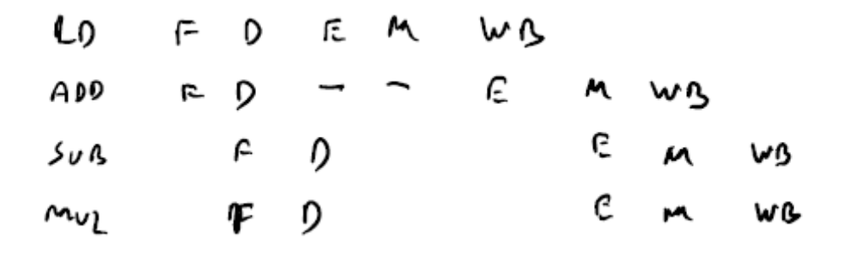
Example (cont.)
In-order execution
There are five pipeline stages and load has latency of 2 clock cycles
Fetch, Decode, Execution, Memory access and Write back are the pipeline stages
Total number of cycles is 8

Slide 6
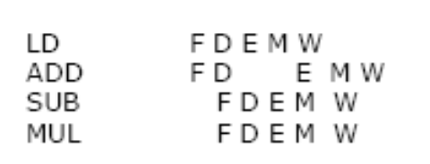
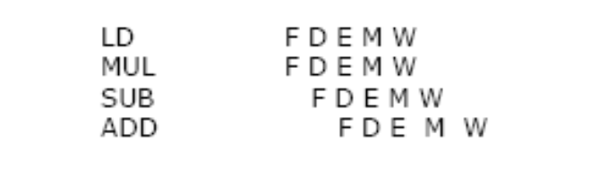
Example (cont.)
Out-of-order execution
There are five pipeline stages and load has latency of 2 clock cycles
Fetch, Decode, Execution, Memory access and Write back are the pipeline stages
Total number of cycles is 7
Solutions

Slide 7
Register renaming
On an out-of-order superscalar processor with 8 execution units, what is the execution time of the following sequence with and without register renaming it any execution unit can execute any instruction and the latency of all instructions is one cycle? Assume that the hardware register file contains enough registers to remap each destination register to a different hardware register and that the pipeline depth is 5 stages.
LD r7, (r8)
MUL r1, r7, r2
SUB r7, r4, r5
ADD r9, r7, r8
LD r8, (r12)
DIV r10, r8, r10 .

Slide 8
Solution
In this example, WAR dependencies are a significant limitation on paralle­lism, forcing the DIV to issue 3 cycles after the first LD, for a total execution time of 8 cycles (the MUL and the SUB can execute in parallel, as can the ADD and the second LD). After register renaming, the program becomes
LD hw7, (hw8)
MUL hw1, hw7, hw2
SUB hw17, hw4, hw5
ADD hw9, hw17, hw8
LD hw18, (hw 12)
DIV hw10, hw18, hw10
(Again, all of the renaming register choices are arbitrary.)
With register renaming, the program has been broken into three sets of two dependent instructions (LD and MUL, SUB and ADD, LD and DIV). The SUB and the second LD instruction can now issue in the same cycle as the first LD. The MUL, ADD, and DIV instructions all issue in the next cycle, for a total execution time of 6 cycles.

Slide 9
Example
Figure on the next slide shows an example of a superscalar processor organization. The processor can issue two instructions per cycle if there is no resource conflict and no data dependence problem. There are essentially two pipelines, with four processing stages (fetch, decode, execute, and store). Each pipeline has its own fetch decode and store unit. Four functional units (multiplier, adder, logic unit, and load unit! are available for use in the execute stage and are shared by the two pipelines ana dynamic basis. The two store units can be dynamically used by the two pipeline depending on availability at a particular cycle. There is a lookahead window with its own fetch and decoding logic. This window is used for instruction lookahead for out-of-order instruction issue.

Slide 10
Example (cont.)
What dependencies exist in the program?
Show the pipeline activity for this program on the processor using in-order issue with in-order completion policies and using a presentation similar to the Figure.
Repeat for in-order issue with out-of-order completion.
Repeat for out-of-order issue with out-of-order completion.

Slide 11
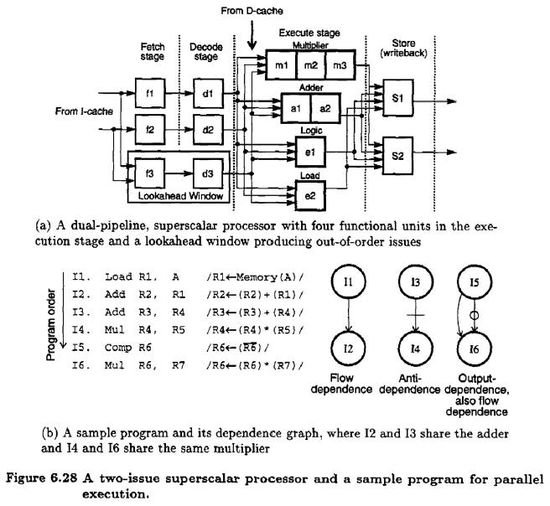

Slide 12
